Slide 1

SIGN LANGUAGE TRANSLATOR FOR SPEECH-IMPAIRED
Date: 09 April 2021
SOMIREDDYGARI SAMIKSHA : 17WH1A0516
TURIYA DANDU : 17WH1A0536
THONDAPU NEELIMA CHOWDARY : 17WH1A0545
Internal Guide: Mrs. Naga Kalyani.Ayyadevara
Designation: Assistant Professor
Department of Computer Science & Engineering
BVRIT HYDERABAD College of Engineering for Women

Slide 2
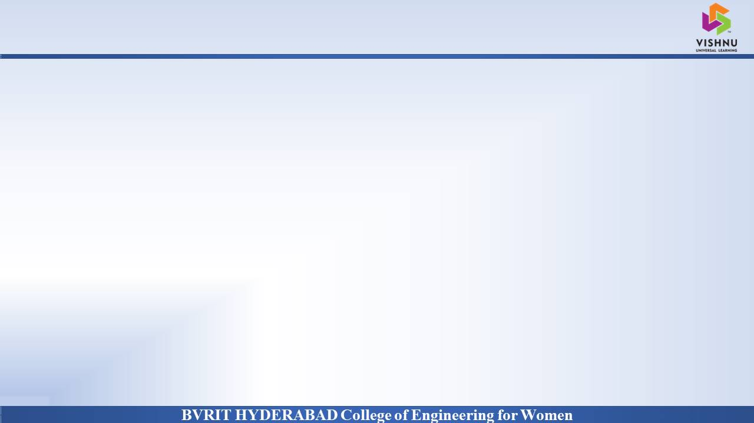
PROJECT INTRODUCTION
Why Should I Study this course?
DOMAIN
Examples
AI/ML
PROBLEM STATEMENT
Our project aims to create a computer application and train a model which when shown a real time video of hand gestures of sign language shows the output for that particular sign in text format
BVRIT HYDERABAD College of Engineering for Women

Slide 3
ABSTRACT
Sign language is one of the oldest and most natural form of language for communication, but since most people do not know sign language and interpreters are very difficult to come by we have come up with a real time method using neural networks for finger based sign language .

Slide 4
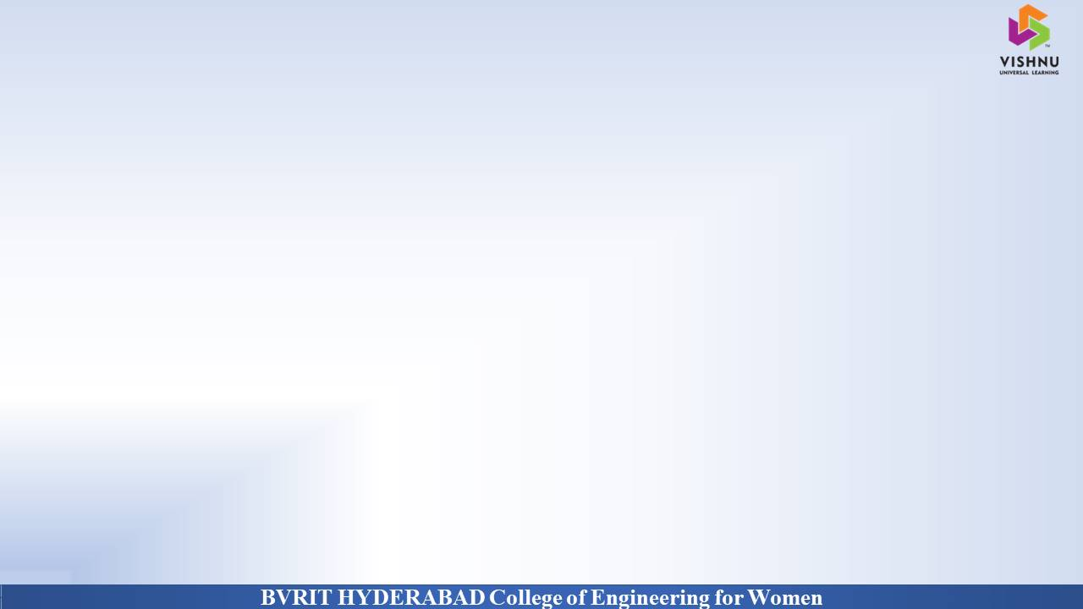
SYSTEM SPECIFICATIONS
ENVIRONMENT | SPECIFICATIONS
HARDWARE | Processor - Intel Core i5 Memory(RAM) - 8GB Storage - 1TB
SOFTWARE | Python(Keras,tensorflow,Open Cv) OS- Windows 10 Jupyter Notebook
BVRIT HYDERABAD College of Engineering for Women

Slide 5
Base Paper
https://www.sciencedirect.com/science/article/pii/S187705092031526X#:~:text=A%20novel%20approach%20for%20the,and%20bag%20of%20word%20technique.

Slide 6
Thankyou
BVRIT HYDERABAD College of Engineering for Women

